Slide 1
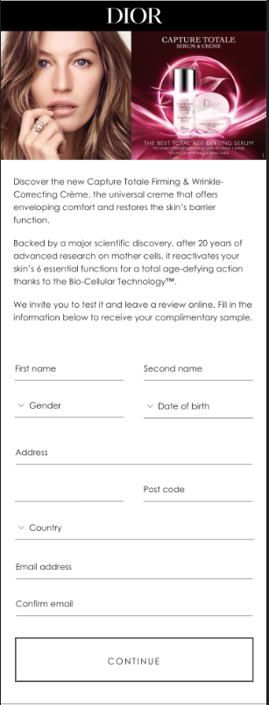
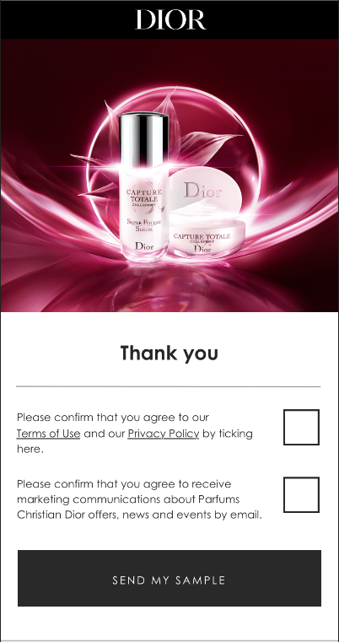
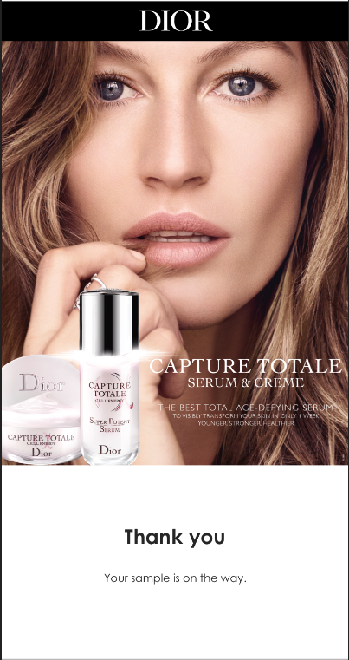
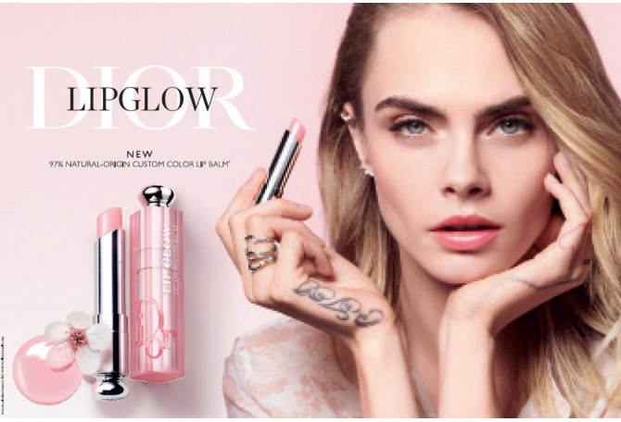
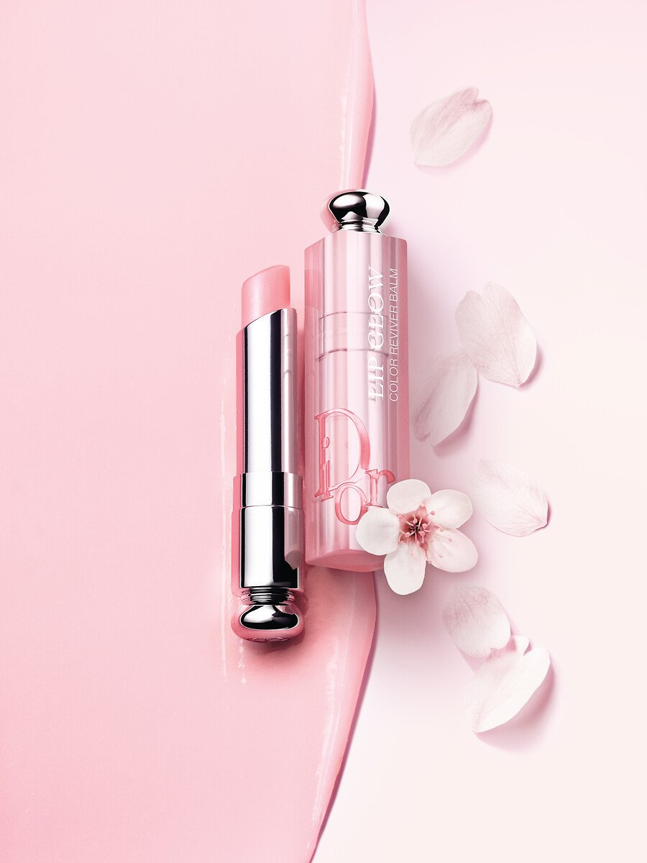
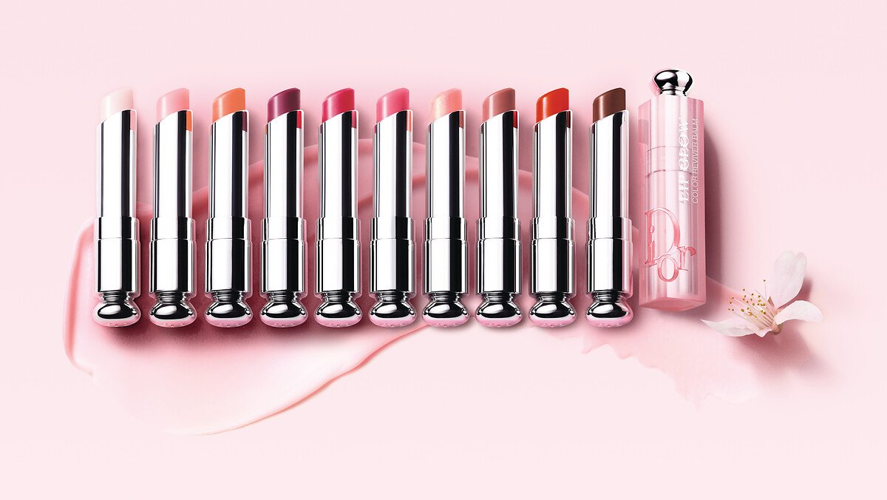
The 1st Dior lip balm formulated with 97% natural-origin ingredients* that subtly revives the color of lips with 24h** hydration and 6H glow***. A unique formula made with natural-origin ingredients infused with cherry oil, shades to suit all skin tones and a new couture case
TO REMOVE
TO REMOVE
GET
*Amount calculated based on the ISO 16128-1 and ISO 16128-2 standard. The remaining ingredients help optimize the formula's sensory appeal and integrity over time
** Instrumental test carried out on 11 subjects.
*** Instrumental test on 20 women.

